Slide 1

iCAP – Individual Career Academic Plan
Required by the State of Oklahoma for all students grades 6-12. Included in the high school graduation requirements.
Your portfolio (all of the items you complete within the OKCollegeStart.org website) should be updated each year.

Slide 2
iCAP Overview – OK State Department of Education
Student will complete an online career assessment every year to explore their career interests, learn career skills, and begin connecting their interests to careers.
Students will update their career and postsecondary goals every year as they learn about new opportunities.
Students will update their required state and federal assessments (English Language Arts, Mathematics, and Science) and College & Career Readiness Assessment (ACT or SAT) results as they become available.
Students will annually update their academic courses and progress in those courses. (Plan of Study)
Students will also list any career technology programs, AP or IB courses, concurrent enrollment courses or career endorsements that reflect progress toward their individual career pathways.
Students will complete at least one in-service learning or work environment activity. Can be a field trip to an industry, a career guest speaker at school, or volunteer service – including school activities like Rock Week.
(www.okedge.org)

Slide 3
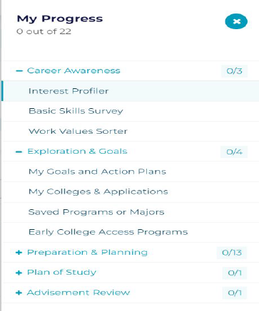
Completion of the iCAP is a relatively new State requirement for graduation. This must be completed in order to receive your diploma. You will update the iCAP multiple times throughout each year of high school.
The following slides will detail each task. There are categories that are not currently required but are helpful.
You will need a copy of your transcript as you work on your iCAP. You will need to log into your Infinite Campus portal. Click here for instructions.
(If the link doesn’t work go to the District’s website > Schools > Bluejay Academy > Locating Your Transcript.)

Slide 4
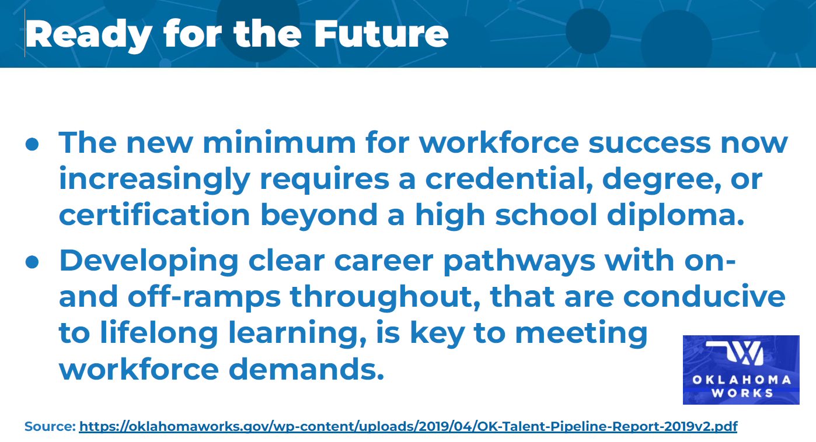

Slide 5
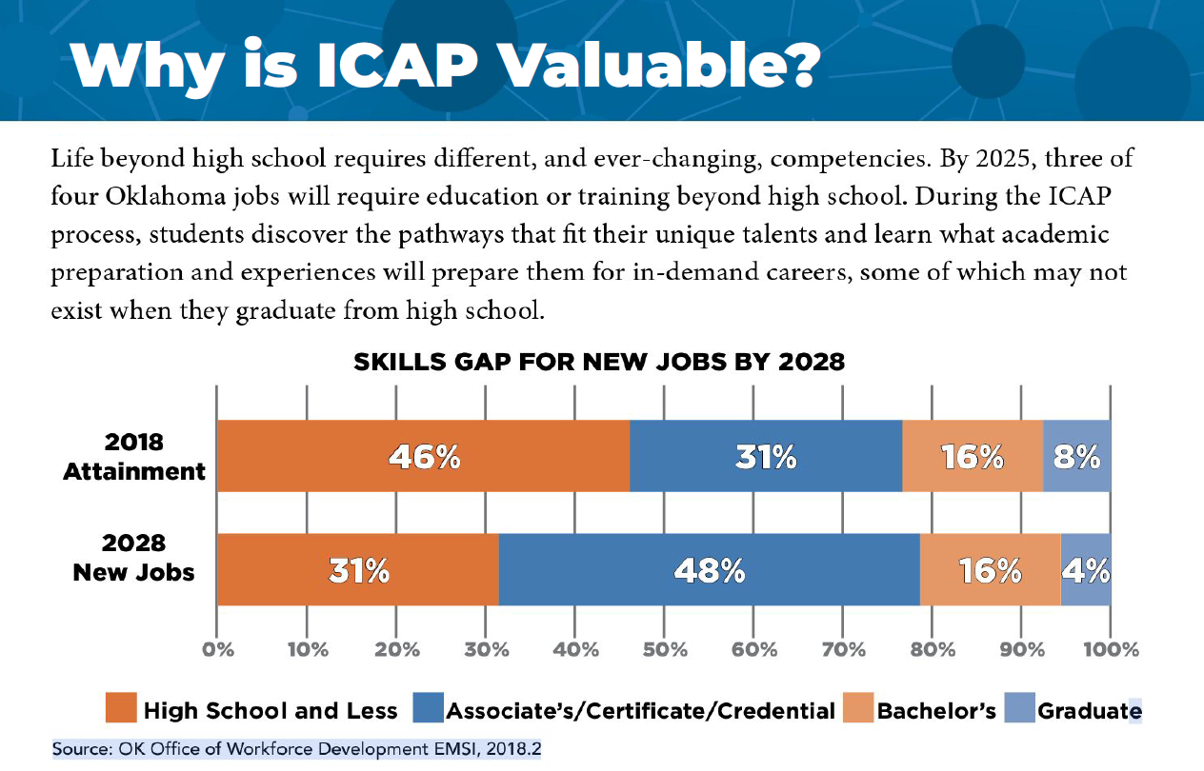

Slide 6
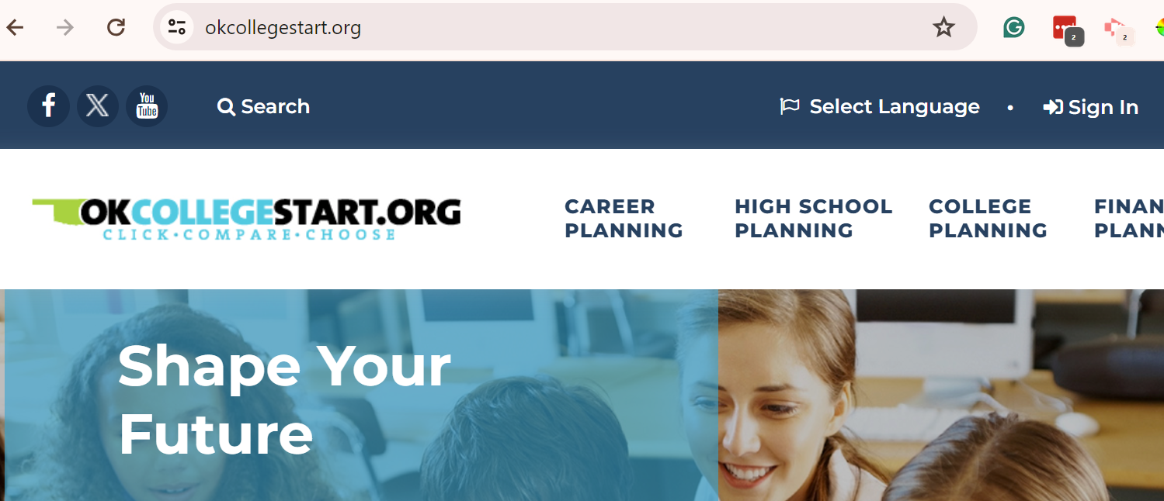
Website: okcollegestart.org
Sign In. Your UserName is your school e-mail address.
Your Password should be Bluejays2 or your Clever password, if different.
If you cannot log in, please contact Mrs. Benson @ juana.benson@guthrieps.net ASAP.
Required Elements:
Career Interest Inventory
Written Post Secondary & Workforce Goals
Plan of Study - update academic progress
Add ACT scores to ICAP portfolio
Add Service Learning or Work-Based Learning

Slide 7
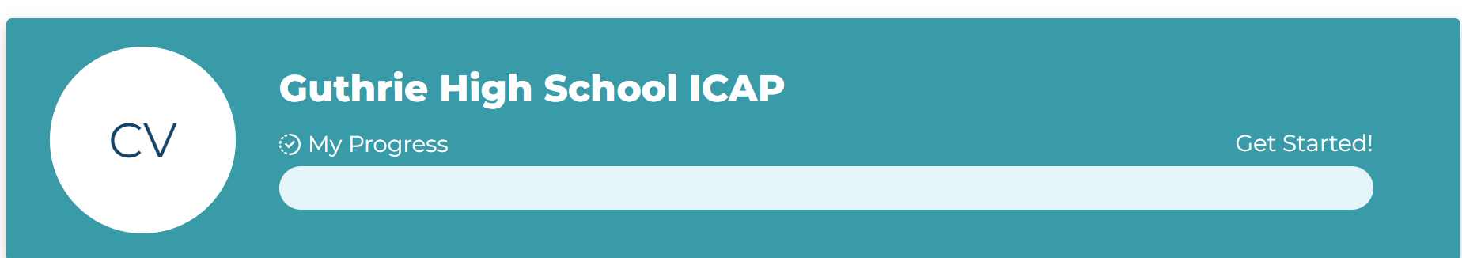
If you click Sign In and see that your account can’t be found, e-mail Mrs. Benson immediately. Do not choose “Create an Account.
If you are prompted to Update Your Password, use Bluejays2 as your password. (It will accept Bluejays2 as the updated password, even if the original password is Bluejays2.)
When signed in, scroll down to the image shown below and click on My Progress.

Slide 8
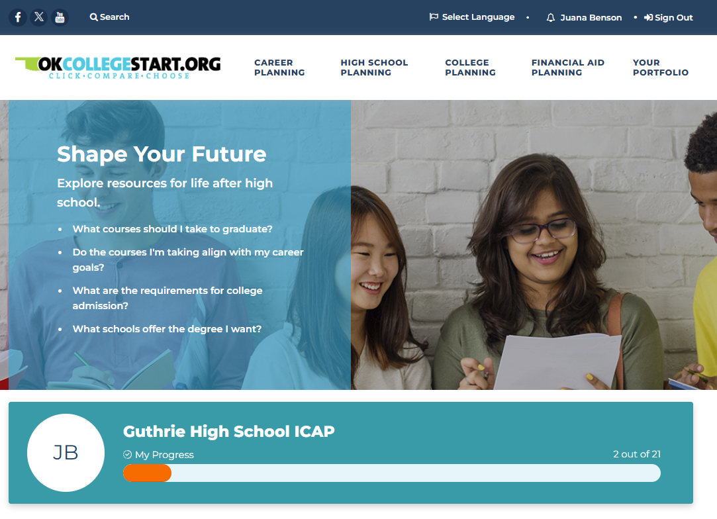

Click on My Progress
Next, verify your grade level or select the correct grade from the drop down menu.
Clicking this icon will open the side panel of section options.

Slide 9
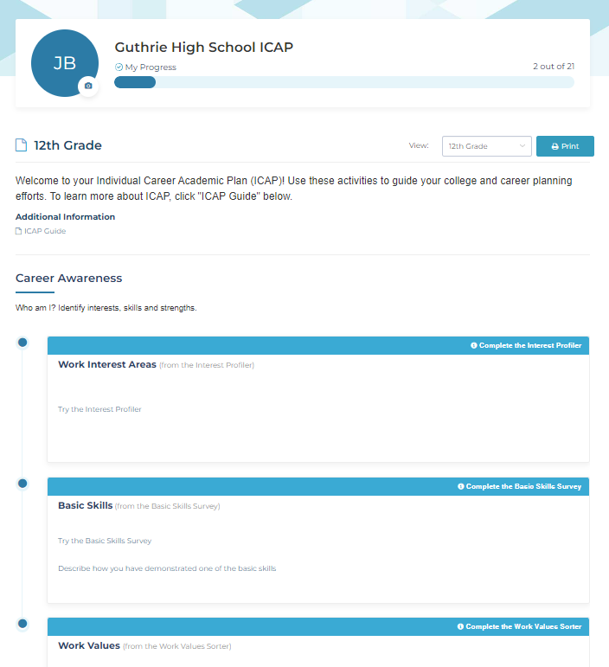
Under Career Awareness, choose Complete the Interest Profiler.
Complete the task.
The Basic Skills & Work Values inventories are not required, unless you are at Faver, but it is helpful if you complete them.

Slide 10
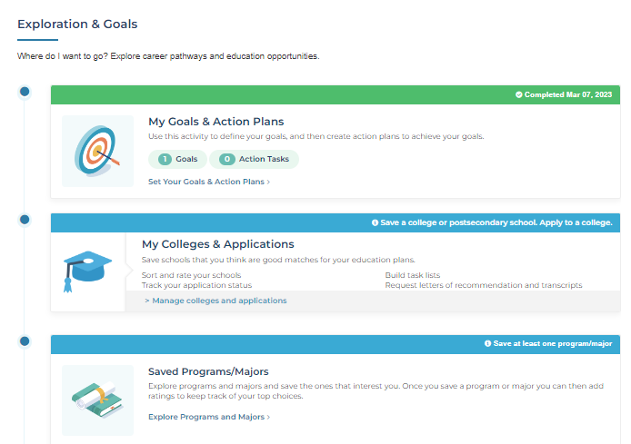
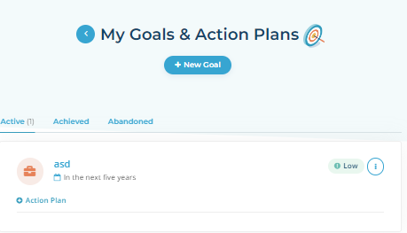
Click My Goals & Action Plans
Click Set Your Goals & Action Plans, then New Goal.
Examples: graduate high school, attend college, join military, find job

Slide 11
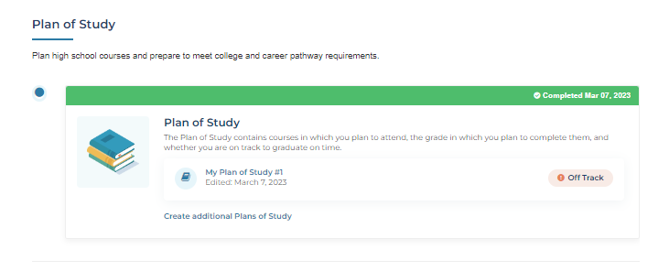


Choose Plan of Study.
Create or Update your Plan of Study.
Using your transcript for reference, add Final Grades from the most recent semester completed. If you have not added grades for prior years, do that also. Add this semester’s classes as “In Progress.”
If you are not exactly sure in which category a course should be, place in the Electives section – see next slide!!

Slide 12
Unless you have submitted an “Opt Out Form,” assume you are on the College/Work Ready "track."
This list is only a partial list of courses you might find on your transcript. Refer to the GHS Course Selection Handbook for more information.
English classes will be listed in the English section.
Algebra, Geometry, PreCalc, Calc, Math of Finance, etc. will be listed in the Math section.
Computer classes, Comp for College & Careers, Web Design, Game Development, etc. will be listed in the Computer / World Language section.
Art-type classes, Music Apprec., Reading for Pleasure, Creative Writing, Choir, Band, Drama, Speech, Yearboook are Fine Arts.
Science classes including Chemistry, Anatomy, Zoology, Physiology are in the Science section.
History classes including Government, Civics, Psychology, Humanities, Geography are listed in the History section.
PE/Health/Wellness type courses are Electives.
Personal Financial Literacy is an Elective – a required course, but listed as an Elective.
Lifeskills, Group, Service Learning, STEAM, Career classes, Test Prep, etc. are Electives.
The "Additional" category will be a course from a core category that has already met its requirements. For example, Psychology or a fourth science course. (Other courses can meet this requirement.)

Slide 13
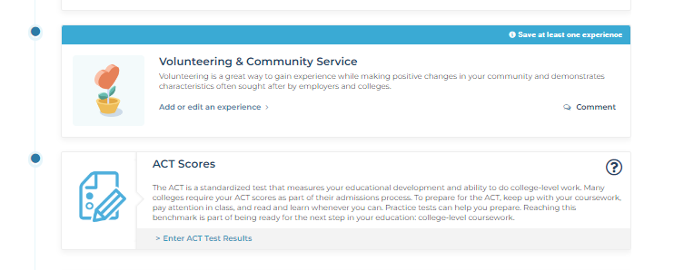
Add Volunteering & Community Service
To be “Volunteer/Community Service,” it must be unpaid. This can be participating in Reading Village, working in the church nursery, Rock Week or Homecoming activities, raking a neighbor’s leaves, watching younger children, visiting with the elderly, or another similar tasks. Activities in Girls Scouts, 4-H, FFA, Boy Scouts, Rainbow, and other organizations can also be included. An activity must be listed.
Add your ACT Score - can be found on your transcript.

Slide 14
Click Add to input your information

Slide 15
ICAP Completion
Your iCAP needs to be completed no later than the day you take your finals!!! If it is not, you will need to allow time to remain at Faver to complete it.
The sections listed are the only ones that must be completed.
Therefore the progress bar will probably never show “Complete or 21/21.”
Your plan of study “should” show “On Track” unless you are behind.

